Slide 1
TAGG
Sample Items and Profile
Tagg.ou.edu/tagg

Slide 2
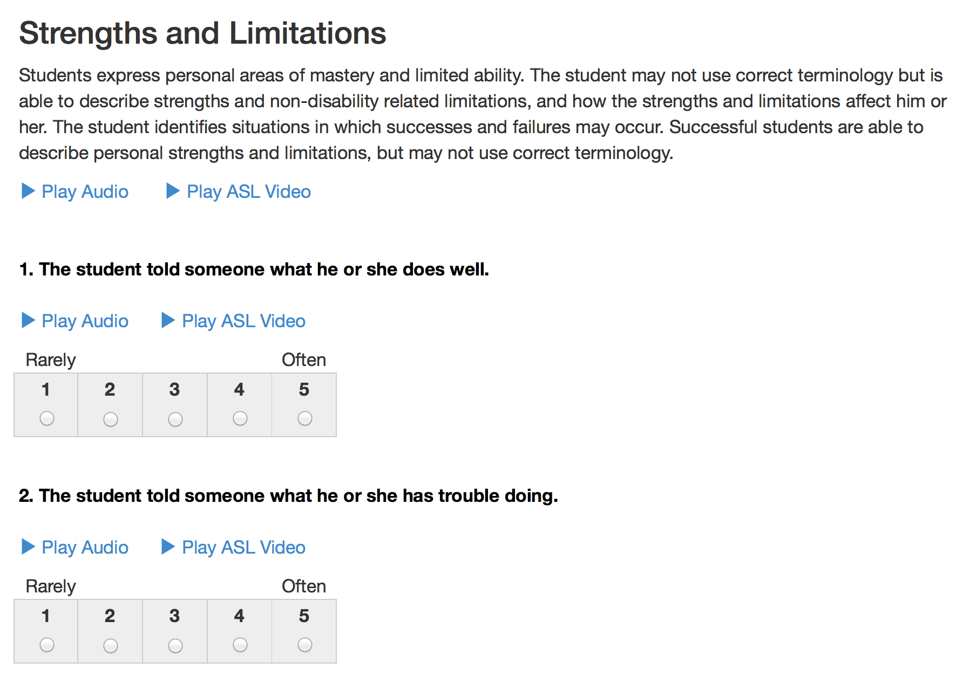

Slide 3
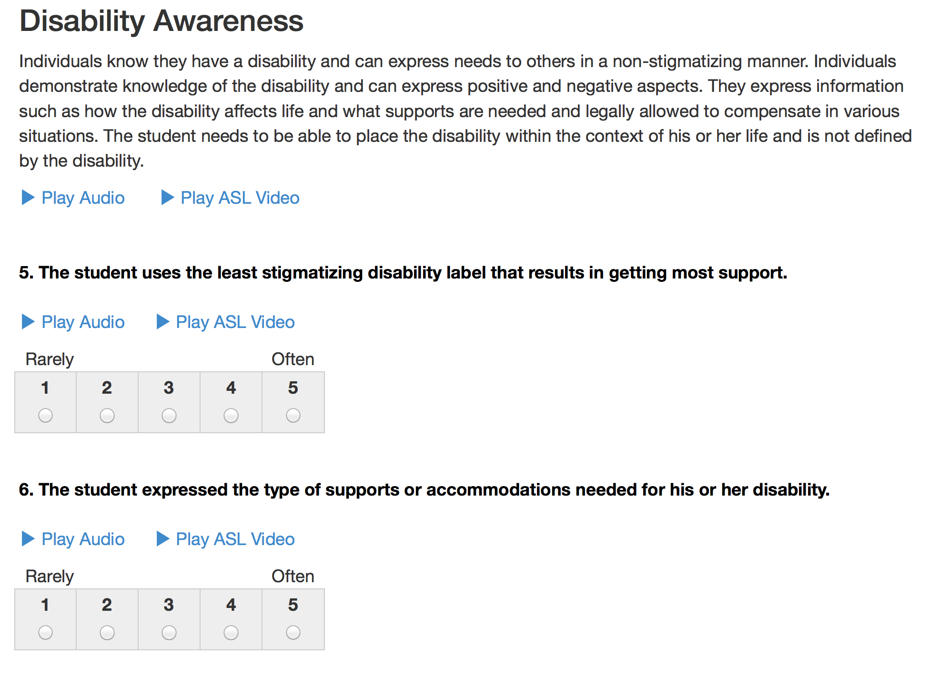

Slide 4
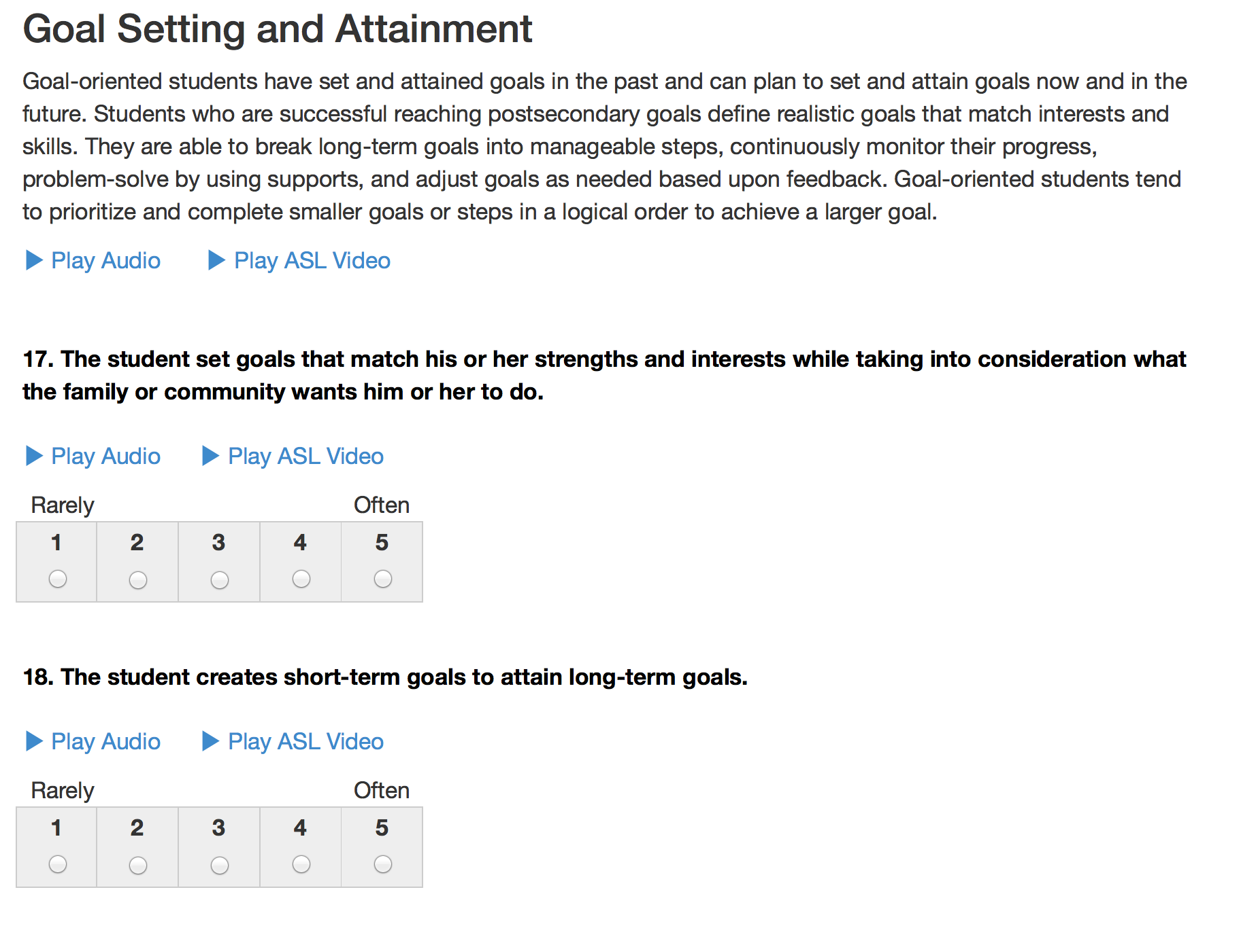

Slide 5
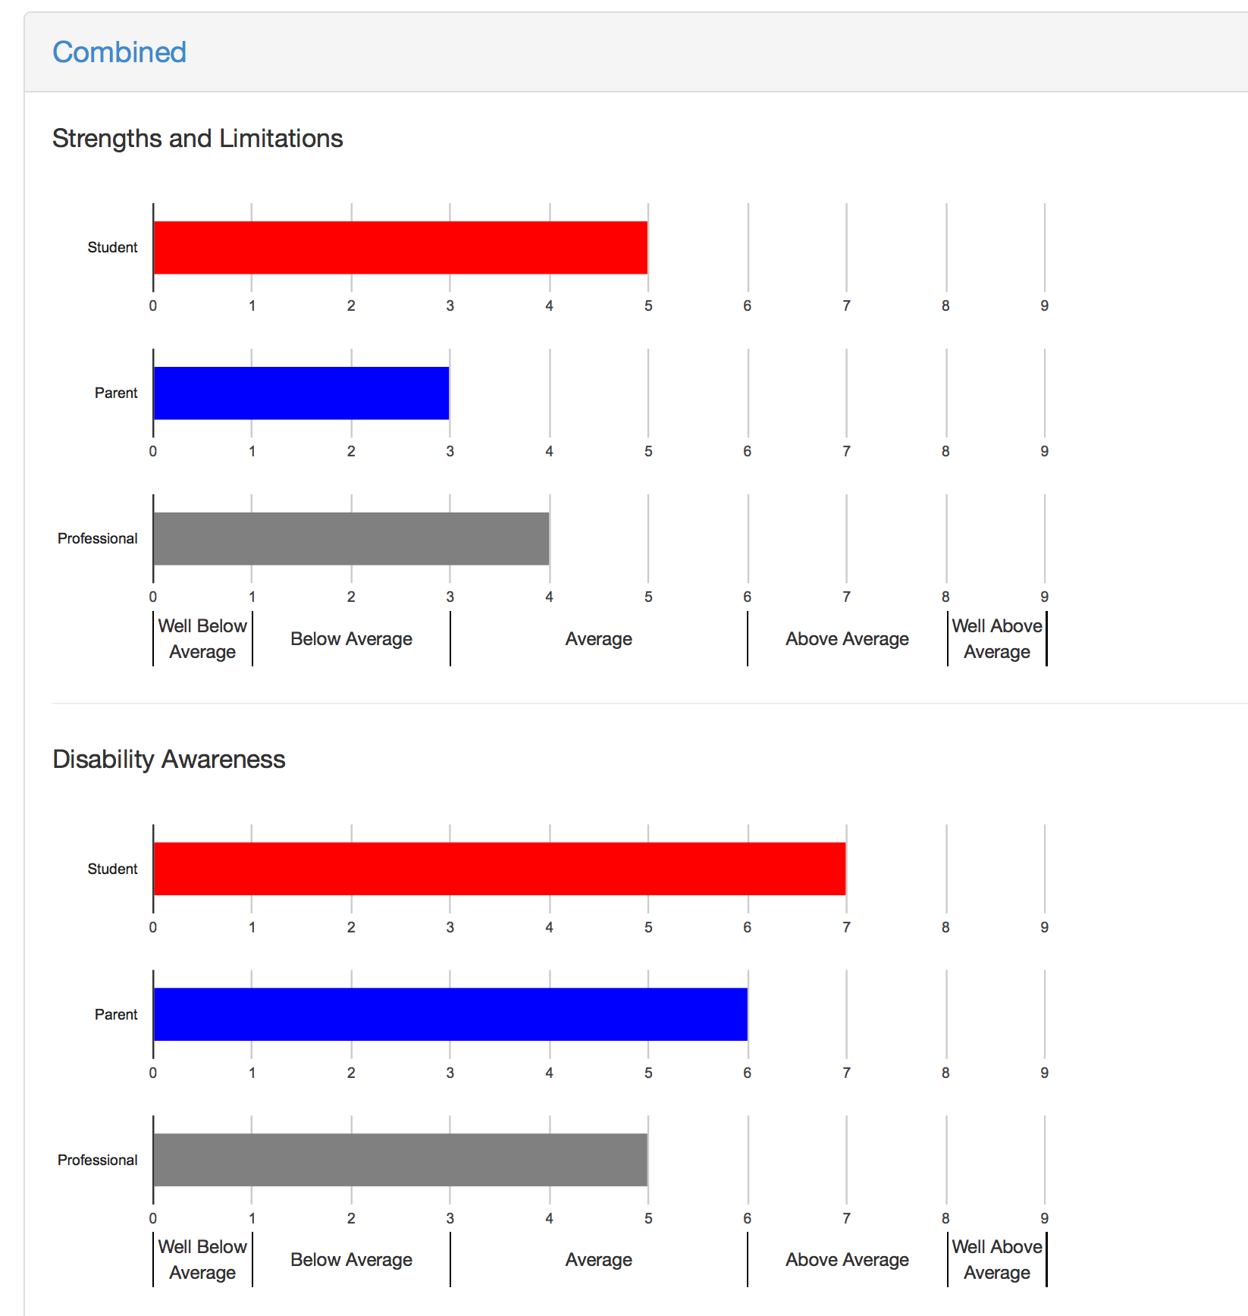

Slide 6
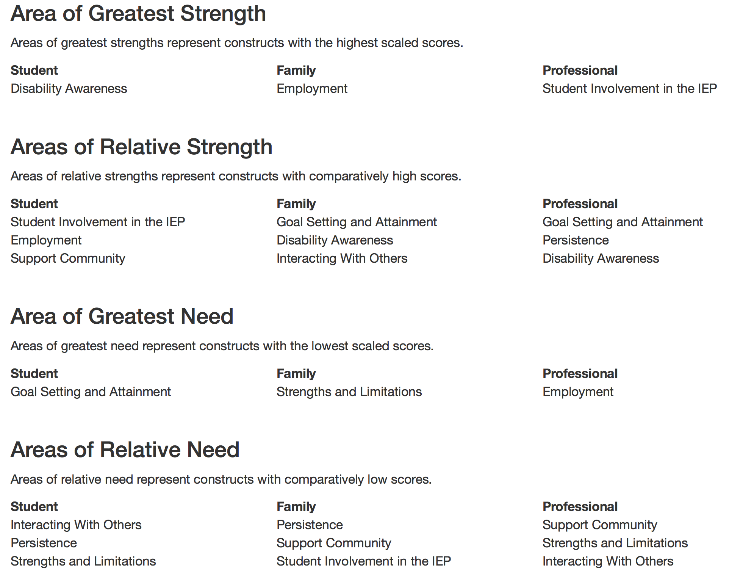

Slide 7


Slide 8
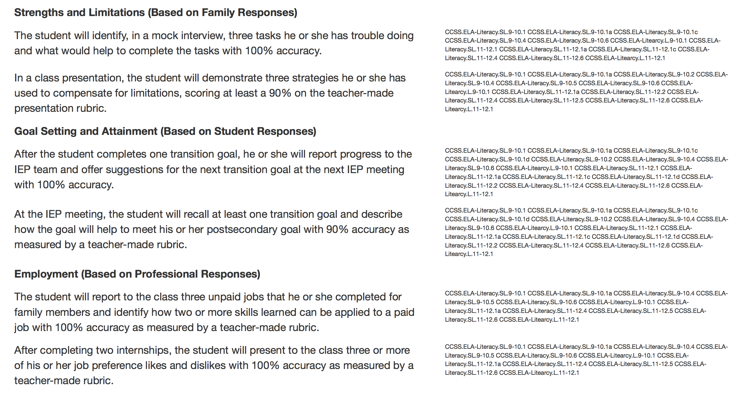

Slide 9
TAGG.OU.EDU/TAGG
For more information, please view the TAGG User’s Guide and Technical Manual at TAGG.OU.EDU/TAGG
OU Zarrow Center for Learning Enrichment
(405)325-8951
TAGG@ou.edu

